Slide 1
Excel - Final Assessment
Emp_ID : 4405

Slide 2
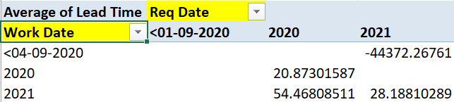
Q-1
→ The Average of Lead Time between ReqDate & Work Date.

Slide 3
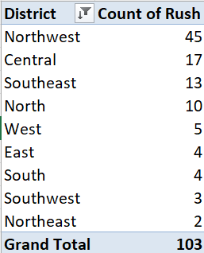
Q-2
→ Northwest District has the highest Rush Jobs

Slide 4
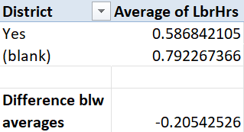
Q-3
→ Blank means “No”
→ Diff blw averages of rush hour jobs & non-rush jobs

Slide 5
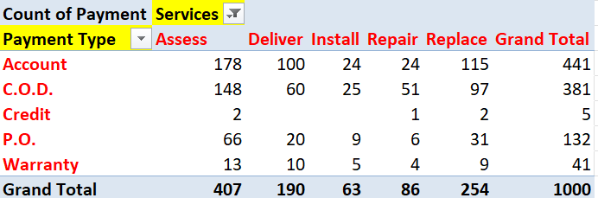
Q-4
→From the above Table we can observe --The Distribution of Payment Types across Different Services

Slide 6
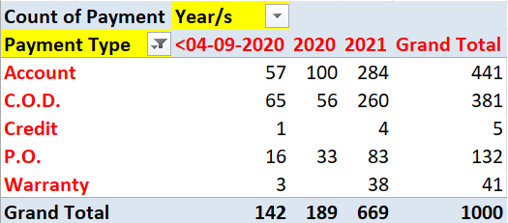
Q-5
→From the above Table we can observe --The Change in the Distribution of Payment Types over the years.

Slide 7
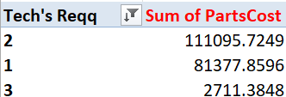
Q-6
→From the above Table we can observe – Even the place where 3 Technicians were required and sum of the parts cost was less than the other two scenarios.

Slide 8
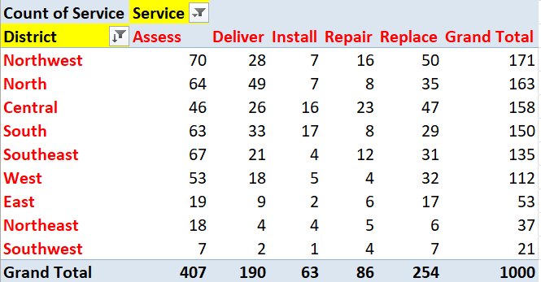
Q-7
→From the above Table we can observe – “Assess” is the most common type of service requested in each district.

Slide 9
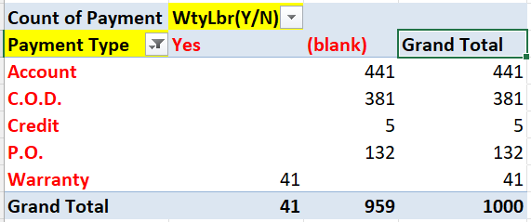
Q-8
→From the above Table we can observe – Only the warranty labours are using the Warranty Payment method and rest are using the other payment methods.

Slide 10
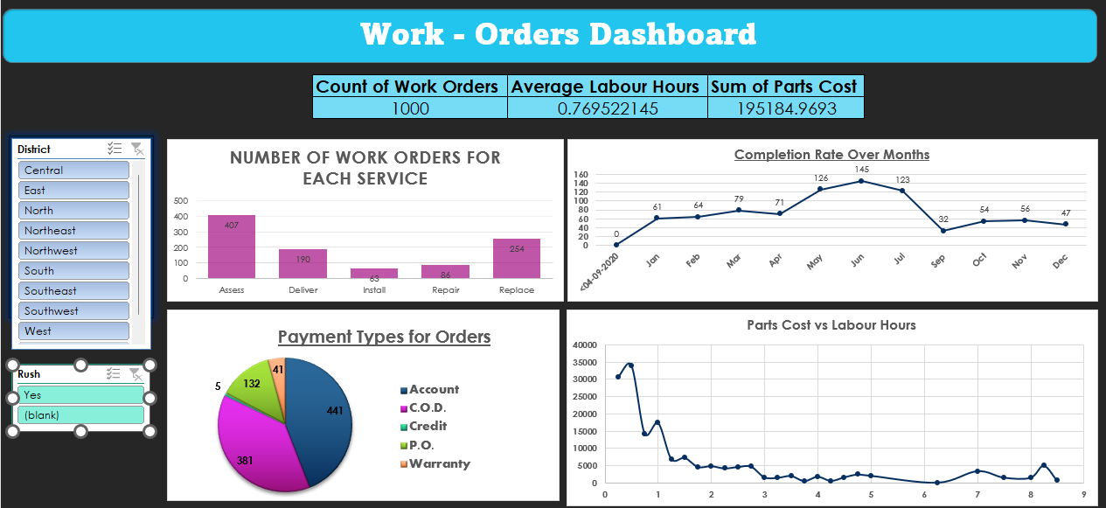
9-Dashboard

Slide 11
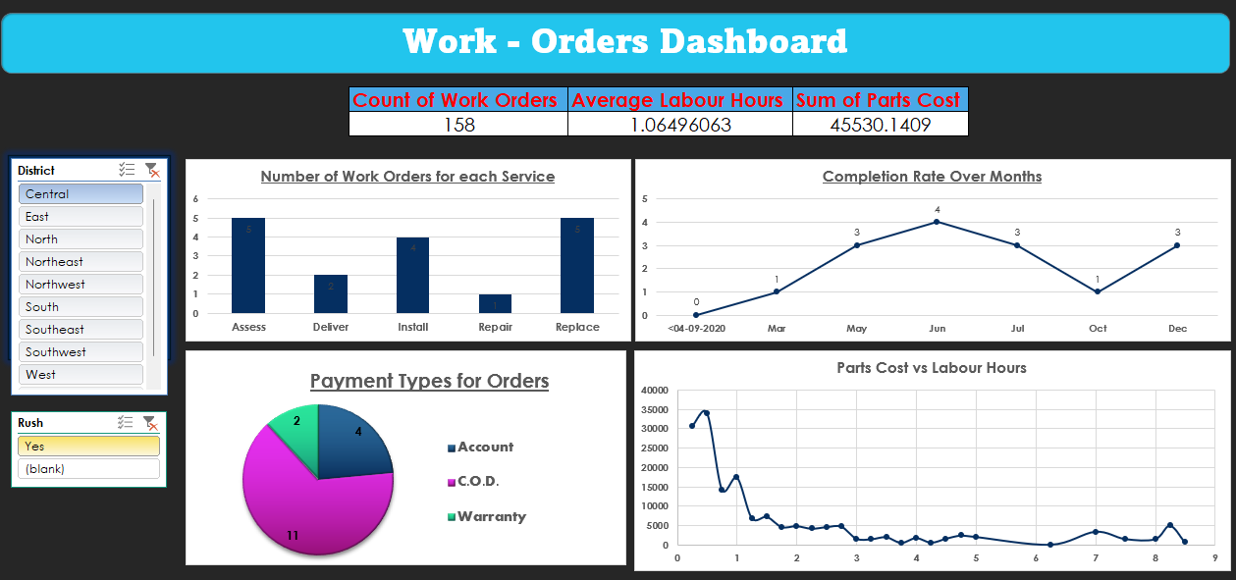
On using slicer

